Slide 1
String Oriented Programming
Circumventing ASLR, DEP, and Other Guards
Mathias Payer
ETH Zurich, Switzerland

Slide 2
Motivation
●
Additional protection mechanisms prevent many existing attack vectors
- return oriented programming(ROP)
- pointer subterfuge
- jump oriented programming(JOP)

Slide 3
Attack model
Code injection
Return Oriented Programming (ROP)
Jump Oriented Programming (JOP)
String Oriented Programming (SOP)

Slide 4
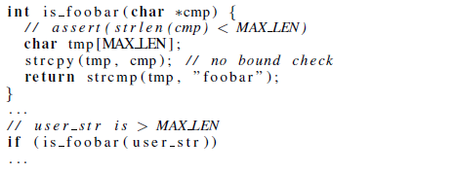
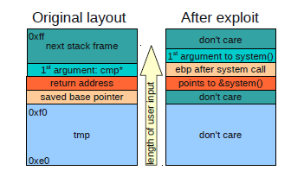
Code injection*
●
Injects additional code into the runtime image
–
Buffer overflow used to inject code as data
leer input
0xffe0

Slide 5
Code injection*
●
Injects additional code into the runtime image
–
Buffer overflow used to inject code as data
●
Modern hardware and operating systems separate data and code
–
Code injection is no longer feasible due to W ⊕ X
If the attacked program uses a JIT then WX pages might be available
–

Slide 6
Return Oriented Programming (ROP)*
●
ROP prepares several stack invocation frames
–
–
Executes arbitrary code
Stack-based buffer overflow as initial attack vector
0xffe0 0xffe0
tmp (don't care)
Gadget catalog (at static addrs)
insns … … ret
insns … … ret
length of user input
0xfff0
0xfff0
insns … … ret
saved base pointer return address
1st argument: usr*
(don't care)
insns … … ret
return address
(data)
return address
next stack frame
0xffff
(data)
return address
0xffff
(data)

Slide 7
Return Oriented Programming (ROP)*
●
ROP prepares several stack invocation frames
–
Executes arbitrary code
Stack-based buffer overflow as initial attack vector
–
●
Executes alternate data with existing code
–
Circumvents W ⊕ X
Hard to get around ASLR, ProPolice
–

Slide 8
Jump Oriented Programming (JOP)*
●
Uses dispatchers and indirect control flow transfers
JOP extends and generalizes ROP
Any data region can be used as scratch space
Scratch space (at static addrs)
–
–
gadget address
Gadget catalog (at static addrs)
(data)
insns … … jmp *
gadget address
insns … … jmp *
(data)
insns … … jmp *
gadget address
insns … … jmp *
(data)
Dispatcher, e.g.,
add %edx, 4; jmp *(%edx)

Slide 9
Jump Oriented Programming (JOP)*
●
Uses dispatchers and indirect control flow transfers
–
–
JOP extends and generalizes ROP
Any data region can be used as scratch space
●
Executes alternate data with existing code
–
Circumvents W ⊕ X
Hard to get around ASLR, ProPolice (if stack data used)
–

Slide 10
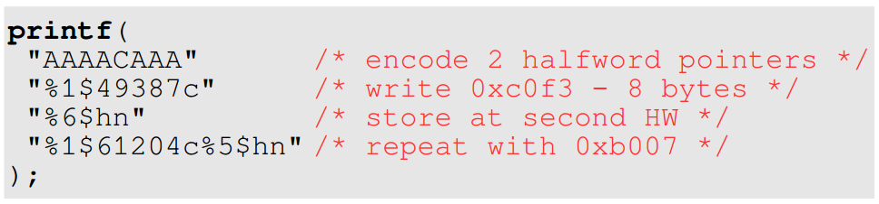
Format string attack*
●
Attacker controlled format results in random writes
–
Format strings consume parameters on the stack
%n token inverses order of input, results in indirect memory write
Often string is on stack and can be used to store pointers
–
–
●
Random writes are used to:
–
Redirect control flow Prepare/inject malicious data
–

Slide 11
String Oriented Programming (SOP)
●
SOP executes arbitrary code (through data)
Needed: format string bug, attacker-controlled buffer on stack
Not needed: buffer overflow, executable memory regions
–
–
●
Executing code
–
–
SOP builds on ROP/JOP
Overwrites static instruction pointers (to initial ROP/JOP gadgets)

Slide 12
String Oriented Programming
●
SOP patches and resolves addresses
–
Application is static (this includes .plt and .got)
Static program locations used to resolve relative addresses
–
●
Resolving hidden functions
ASLR randomizes ~10bit for libraries Modify parts of static .got pointers
Hidden functions can be called without loader support
–
–
–

Slide 13
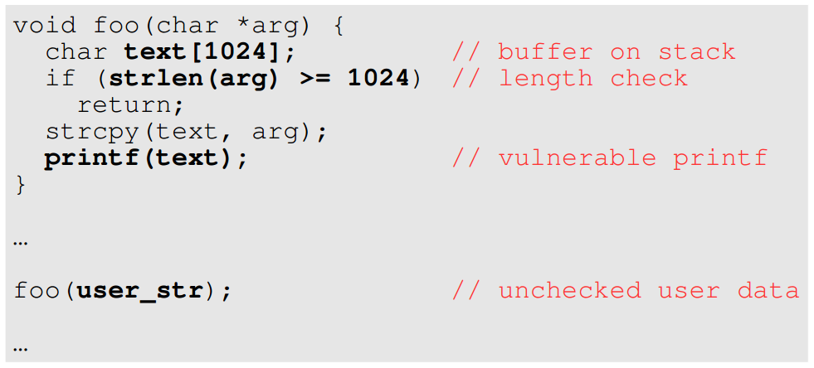
Running example

Slide 14
Protection mechanisms
●
Data Execution Prevention (DEP / ExecShield)
Enforces the executable bit (W ⊕ X) on page granularity Changes: HW, kernel, loader
–
–
●
Address Space Layout Randomization (ASLR)
–
All memory addresses (heap / stack / libraries) are dynamic Application itself is static
Changes: loader
–
–
●
ProPolice (in gcc)
–
Uses canaries on the stack to protect from stack-based overflows
Changes: compiler
–

Slide 15
SOP: No Protection
●
All addresses are known, no execution protection, no stack protection
–
Redirects control flow to code in the format string

Slide 16
SOP: Only DEP
DEP prevents code injection, rely on ROP/JOP instead GNU C compiler adds frame_lift gadget
●
●

Slide 17
SOP: DEP & ProPolice
●
ProPolice uses/enforces stack canaries
–
Reuse attack mechanism, keep canaries intact

Slide 18
SOP: ASLR, DEP, ProPolice
●
Combined defenses force SOP to reuse existing code
- Static code sequences in the application object - Imported functions in the application
(.plt ，.got)
- Place data in RW section
- Redirect imported function (JOP)
- Use ROP for fun & profit

Slide 19
Conclusion
●
String Oriented Programming (SOP)
Relies on format string exploit
Extends data oriented programming (ROP / JOP) Naturally circumvents DEP and ProPolice Reconstructs pointers and circumvents ASLR
–
–
–
–

Slide 20
谢谢！

